Slide 1
Maximum Power Transfer
Section 4.8
Md. Shafqat Talukder Rakin
Lecturer, Department of CSE,
United International University
Email id : shafqat@cse.uiu.ac.bd

Slide 2
Our goal
In many practical situations, a circuit is designed to provide power to a load
There are applications in areas such as communications where it is desirable to maximize the power delivered to a load
We need to find the equation to maximize power delivered to a load

Slide 3


Slide 4
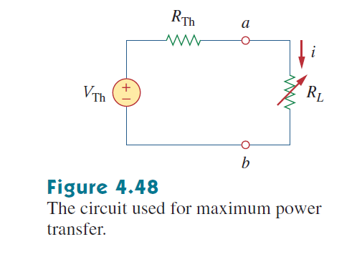

Power calculation

Slide 5
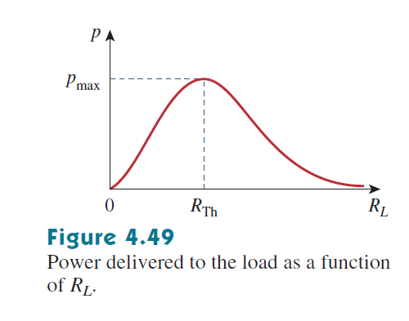
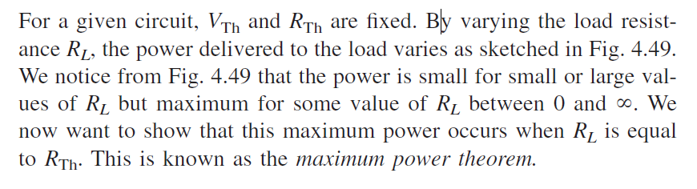
Power calculation

Slide 6

Maximum power transfer

Slide 7
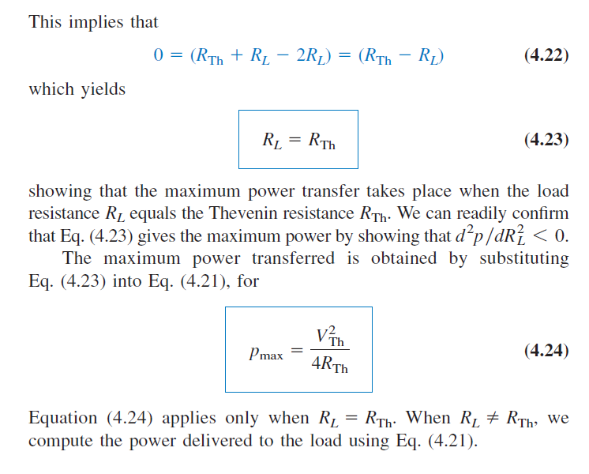
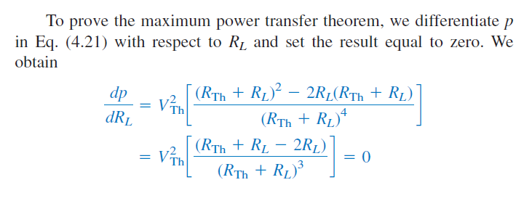
Proof of Maximum power transfer

Slide 8
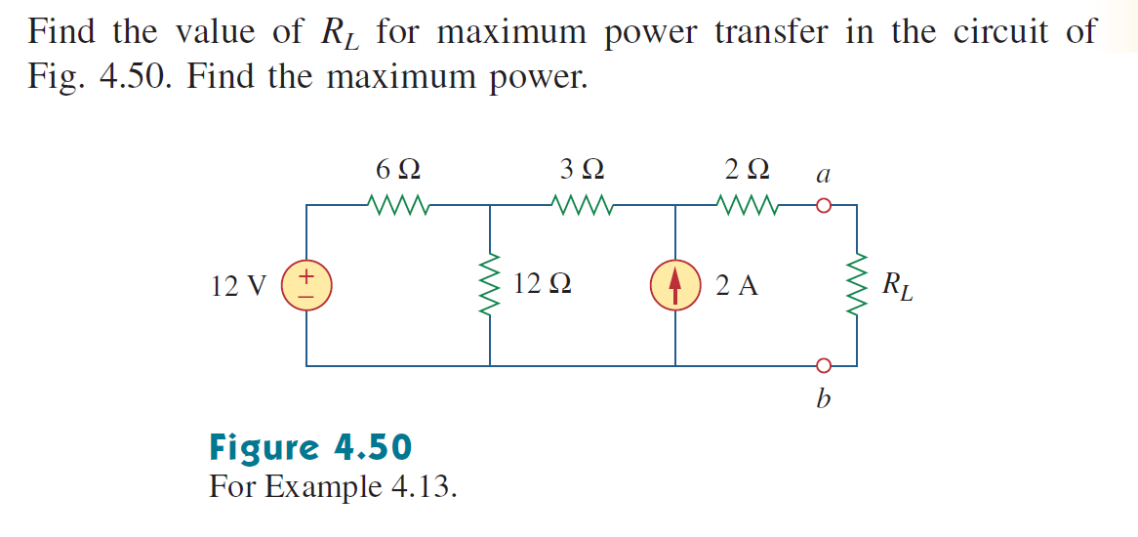
Math Problem Practice:
Reference: Sadiku_Example_4.13

Slide 9
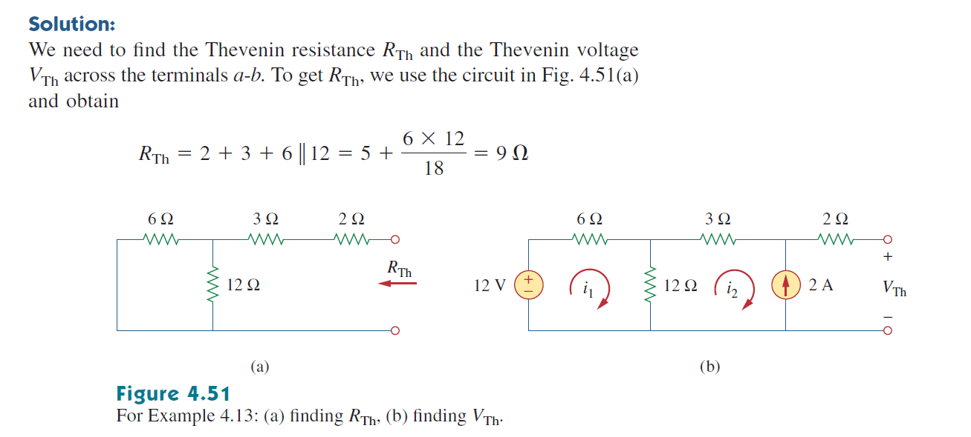
Math Problem Practice:
Reference: Sadiku_Example_4.13

Slide 10
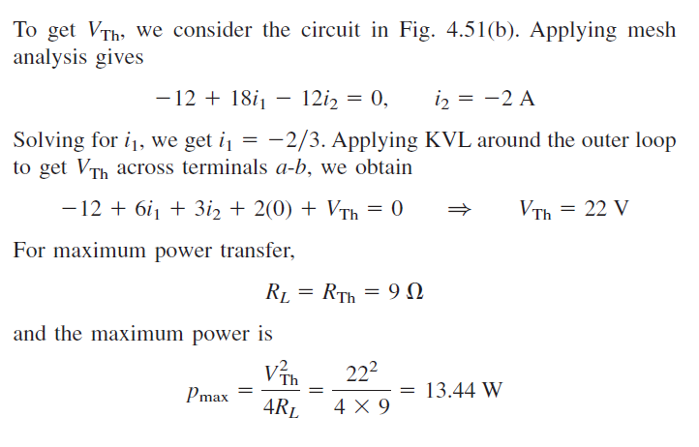
Math Problem Practice:
Reference: Sadiku_Example_4.13

Slide 11
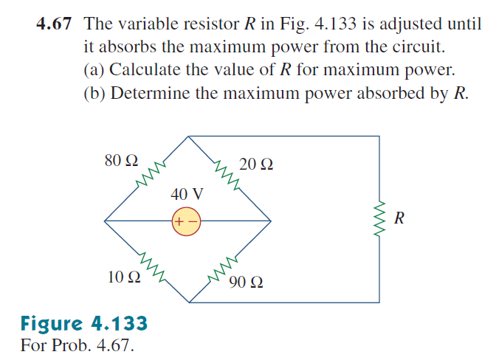
Math Problem Practice:
Reference: Sadiku_Exercise_4.67

Slide 12
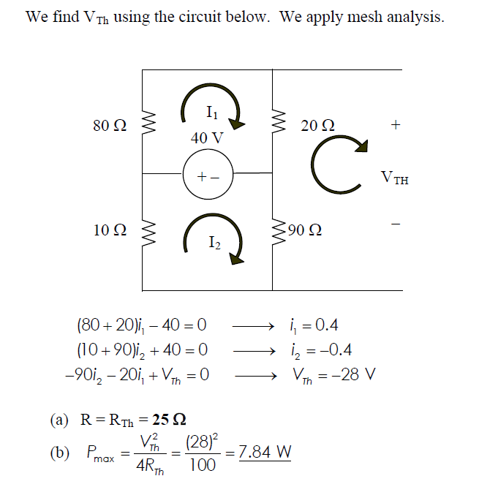
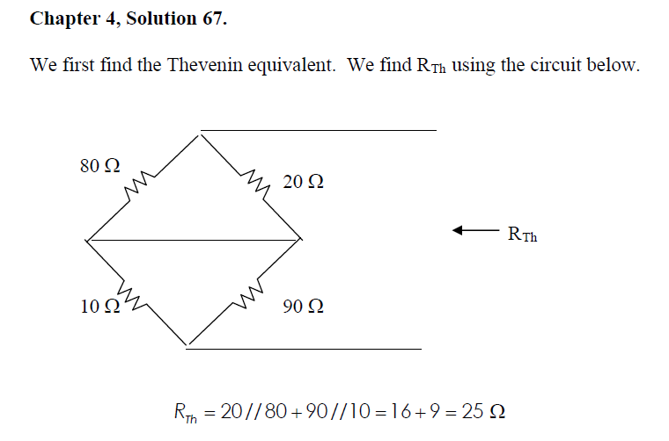
Math Problem Practice:
Reference: Sadiku_Exercise_4.67

Slide 13
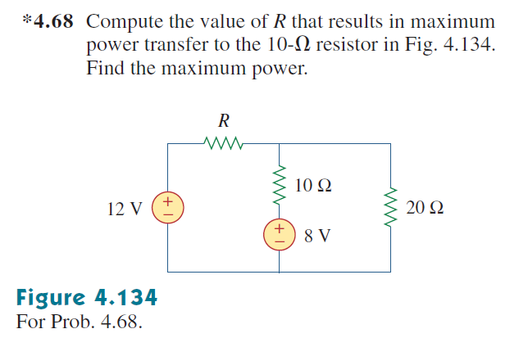
Math Problem Practice:
Reference: Sadiku_Exercise_4.68

Slide 14
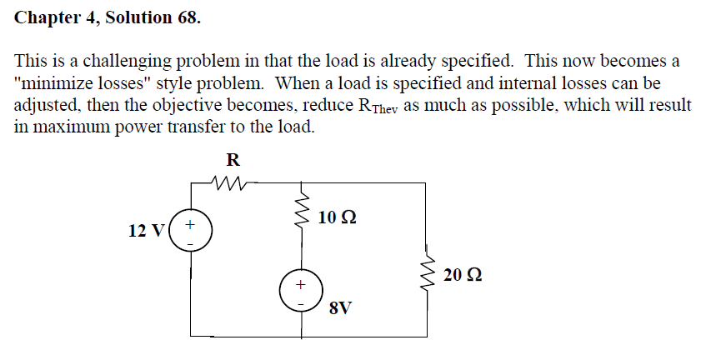
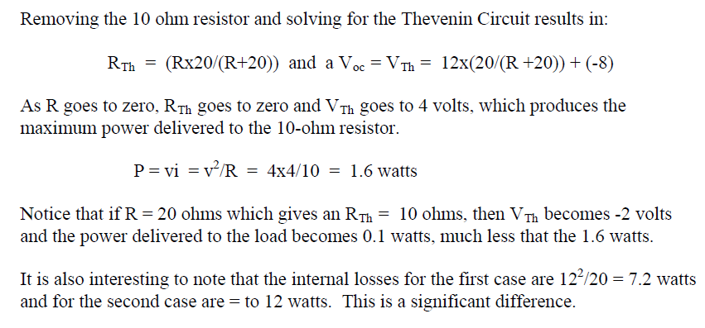
Math Problem Practice:
Reference: Sadiku_Exercise_4.68

Slide 15
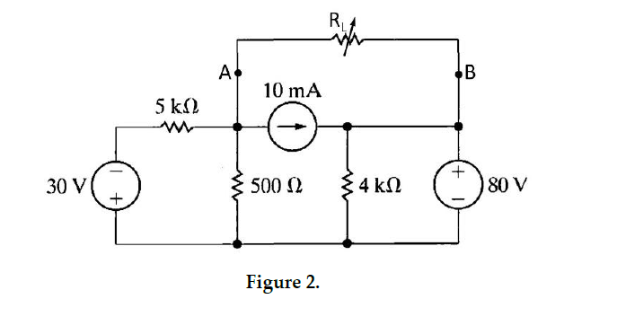

Fall 2023

Slide 16
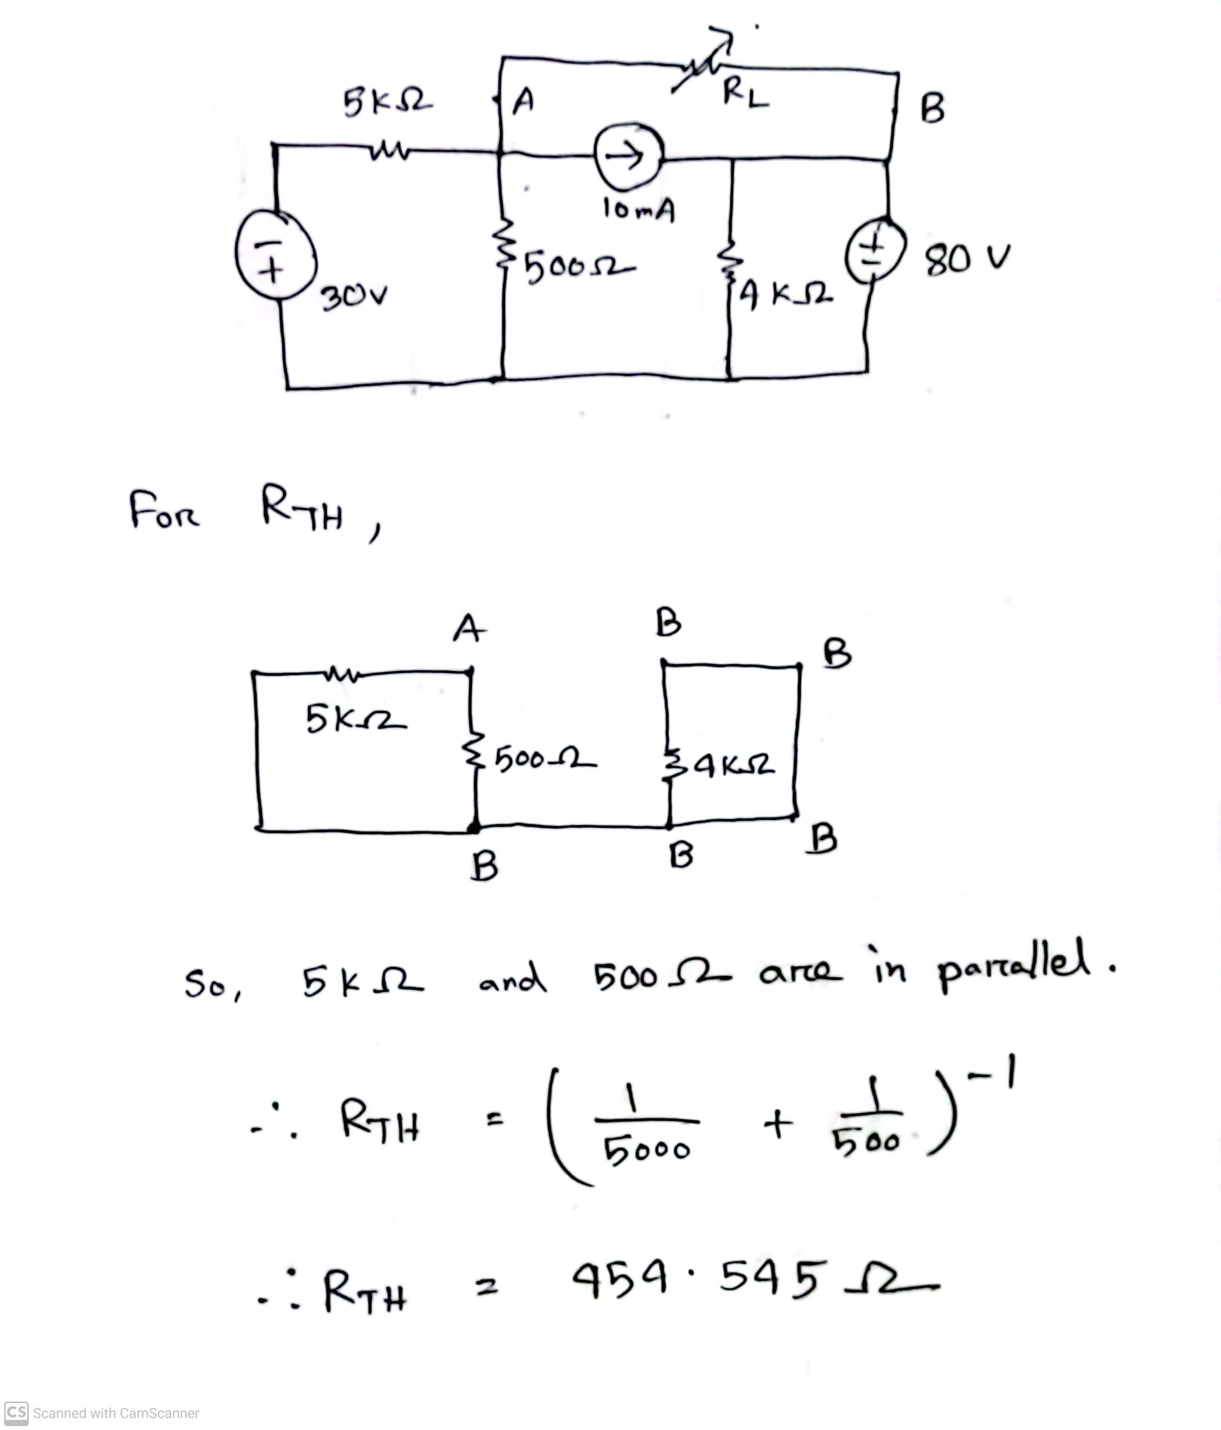
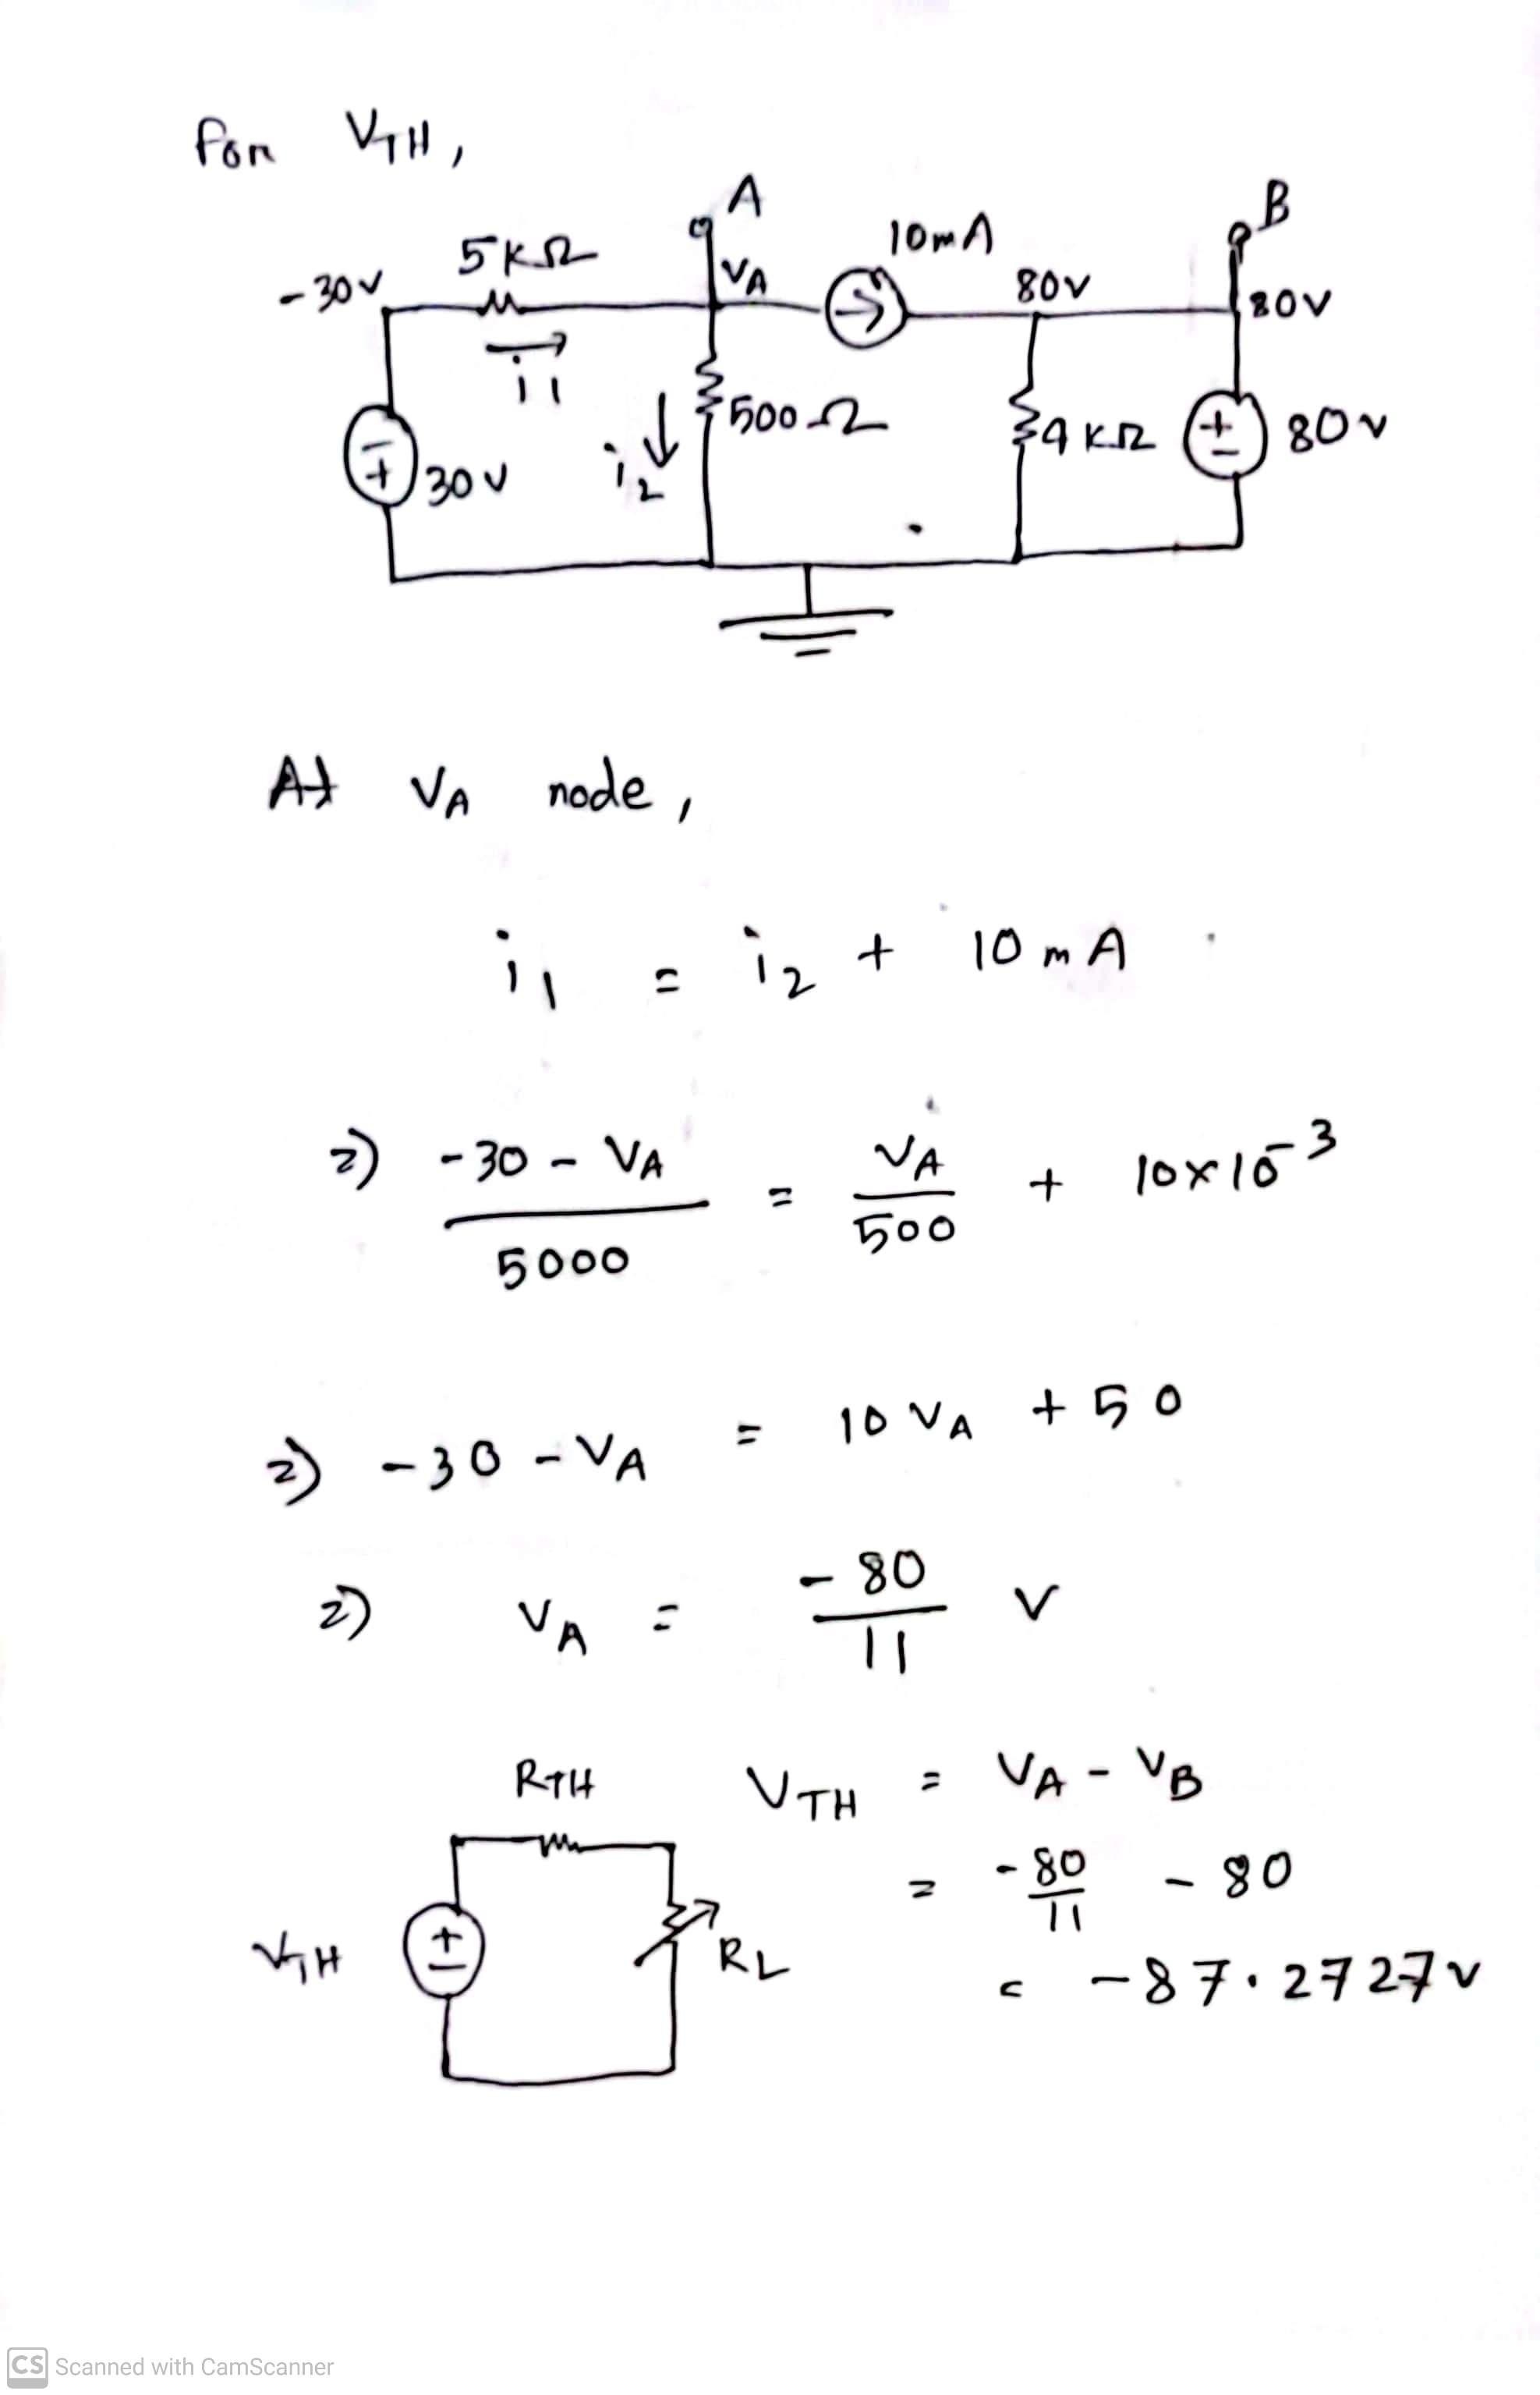
Fall 2023

Slide 17
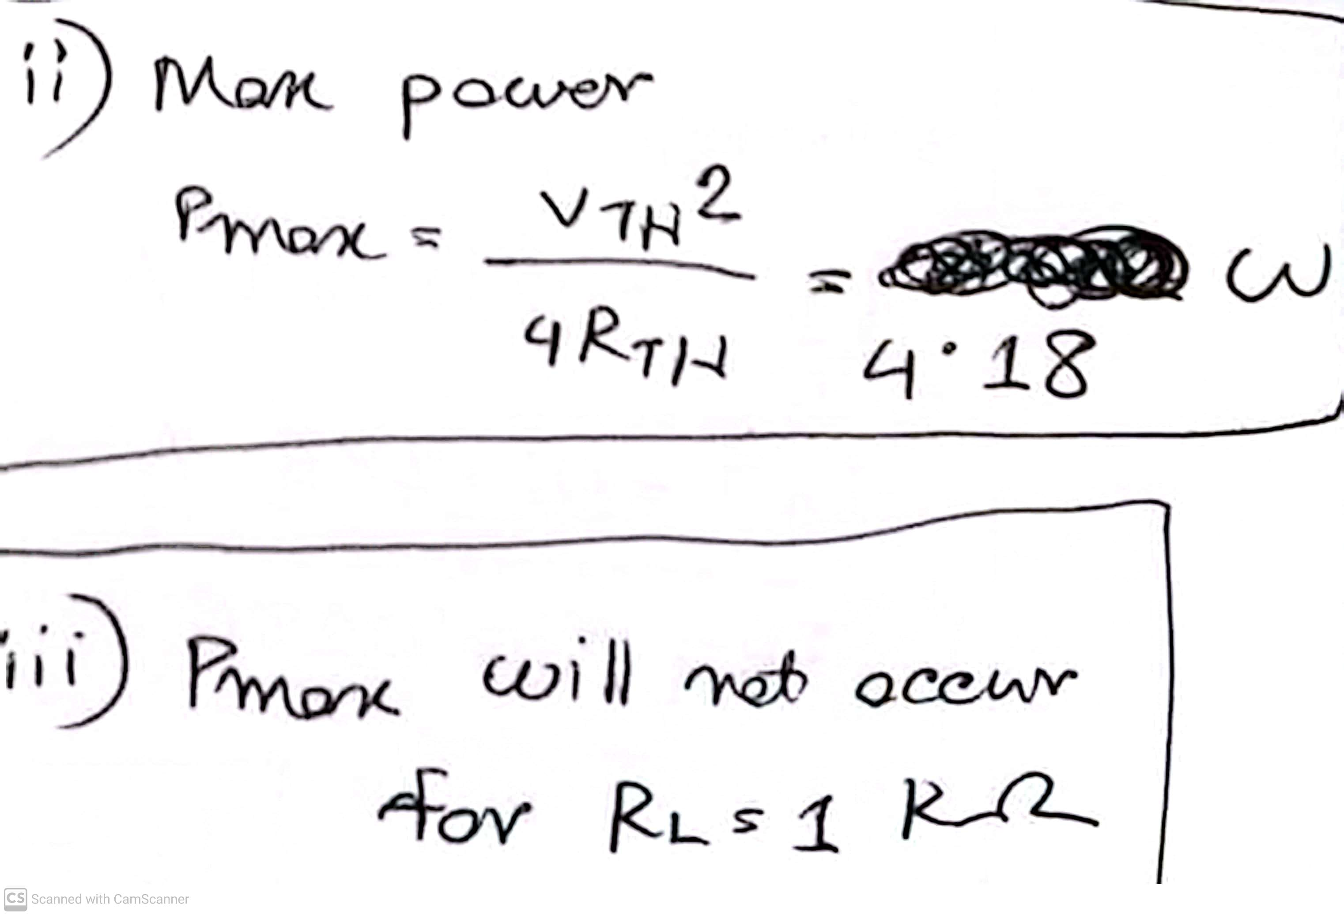
Fall 2023

Slide 18
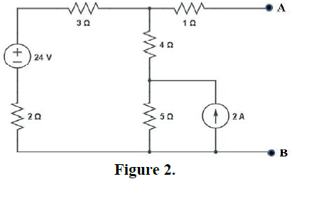
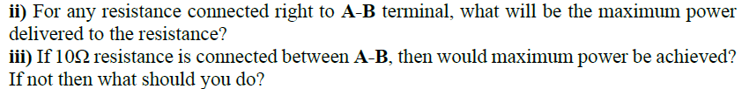
Summer 2023

Slide 19
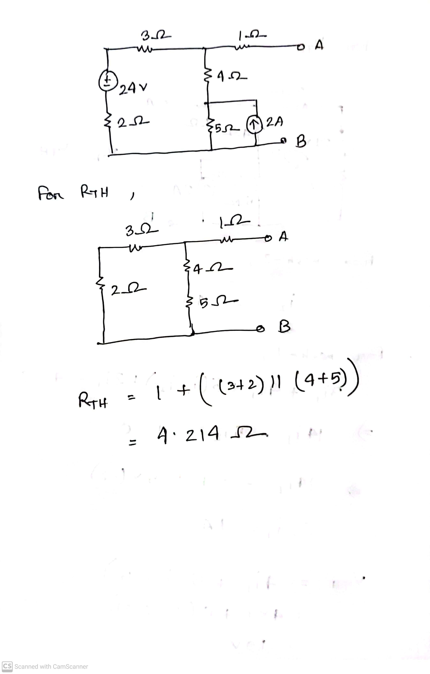
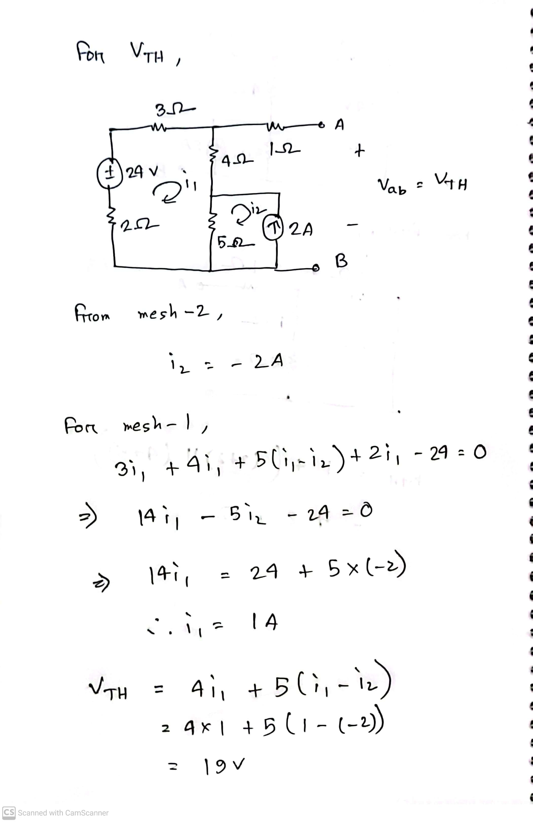
Summer 2023

Slide 20
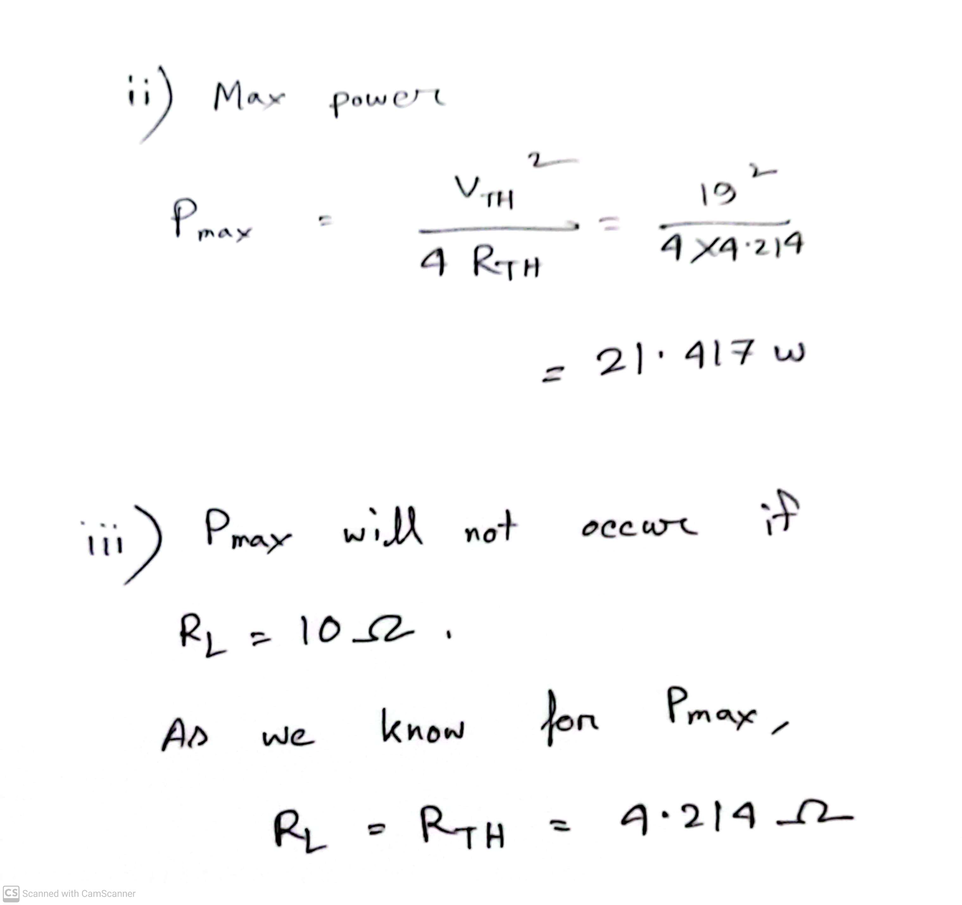
Summer 2023

Slide 21
Short circuit reference
What is SHORT CIRCUIT - Explained with Example | Basics of Electronics (youtube.com)
What is Short Circuit ? Easiest Explanation | TheElectricalGuy (youtube.com)
The Concept of Short Circuit (youtube.com)

Slide 22
Math to Practice from the Book for Exam
Maximum Power Transfer theorem:
Example:
4.13
Problem:
4.67, 4.68
N:B: Please note that Circuits with Independent sources only, for Thevenin’s theorem and maximum power transfer!

Slide 23
Thank you

